Slide 1

Dimension Reduction by Ring Projection Pipeline Module
Bui Nhat Quang
Matriculation number: 1148709
Master IT Course
Software Engineering
Supervised by:
Prof. Andreas Pech / Mr. Damir Dobric

Slide 2
Contents
Introduction
LearningAPI
Ring-Projected Algorithm
Methods
Implementation
Unit Test
Result
Discussion

Slide 3
Introduction
LearningAPI
Machine Learning libraries
.NET Core
Pipeline Module
Ring-Projected Algorithm

Slide 4
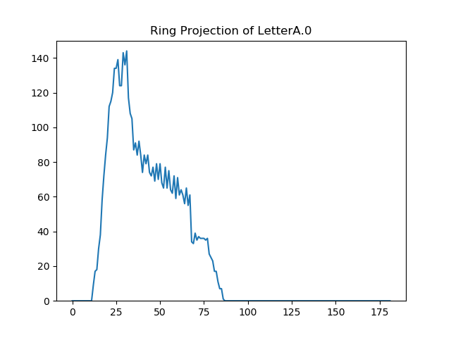

Ring-Projected Algorithm
Fig. 1. Loop iteration of Ring-Projected Algorithm
Fig. 2. Ring-Projected function of letter A

Slide 5
Implementation
Code explanation

Slide 6
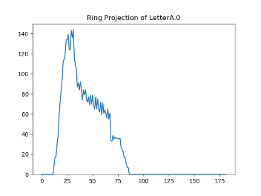
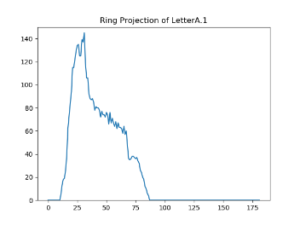
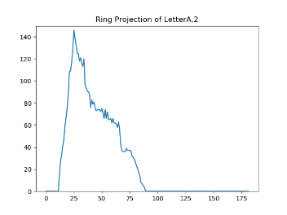
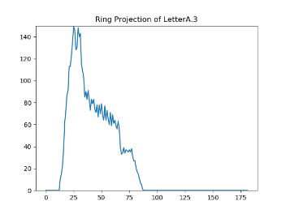




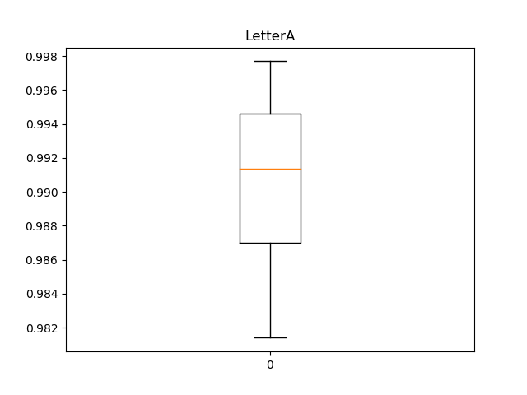
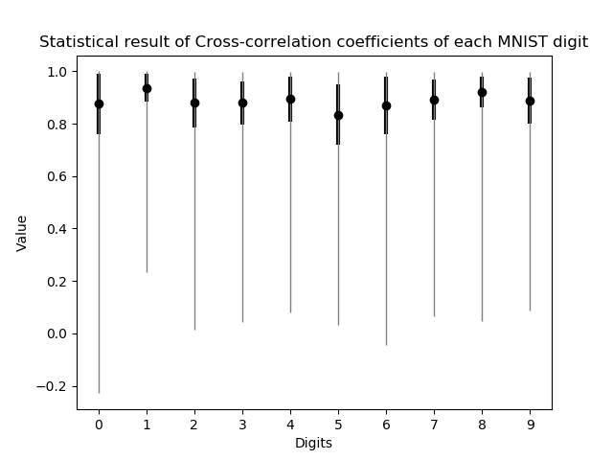
Results
Fig. 3.Box plot of correlation coefficients corresponding to ring-projected functions of letter A
Fig. 4. Visualization of the relation among MNIST images with the same label

Slide 7
Thank you for your listening

Slide 8
References
Open Source, "UniversityOfAppliedSciencesFrankfurt/LearningApi: Machine Learning foundation on top of .NET Core," 2019. [Online]. Available: https://github.com/UniversityOfAppliedSciencesFrankfurt/LearningApi. [Accessed 11 02 2019].
G.-C. Pan, "A Tutorial of Wavelet for Pattern," Taipei.
Y. LeCun, C. Cortes and C. J. Burges, "MNIST handwritten digit database, Yann LeCun, Corinna Cortes and Chris Burges," 1998. [Online]. Available: http://yann.lecun.com/exdb/mnist/. [Accessed 2019].

